Slide 1

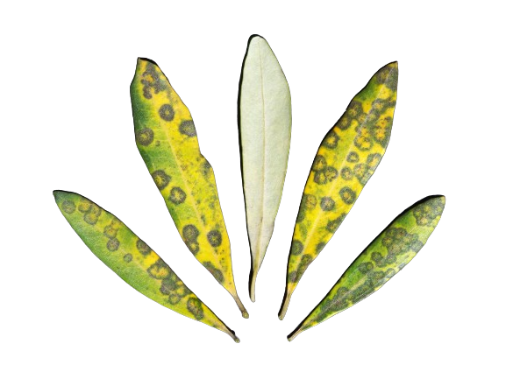
Olive Tree Peacock Disease Prediction
Machine Learning

Slide 2


Project Goals
Develop an Effective Machine Learning Model.
Improve Disease Detection in Olive Trees in Palestine West-Bank.
Contribute to Agricultural Research and Sustainability .

Slide 3

Disease Introduction
Olive tree peacock disease, is a fungal disease that commonly affects olive trees . This disease primarily targets the leaves of olive trees, causing characteristic circular lesions or spots on the leaf surface. These lesions often resemble the colorful patterns found on the tail feathers of a peacock.

Slide 4
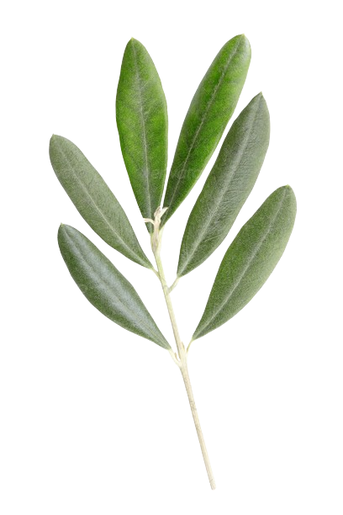
Visualization
Normal Leaf
Leaf With peacock Disease

Slide 5

Project Scope
Create a simple Machine Learning Model.
Recognize Peacock Disease in Olive Trees
Detect Small Circular Lesions on Leaves

Slide 6

Data Source
The data has been collected from various cities in palestine west-bank including Nablus, Tulkarem, Qalqilya and more.
Sourced from Prof.Mazen Salmans Research, Professor and Researcher at Al-Khadourie University .

Slide 7
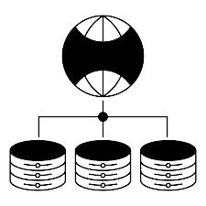
Data Volume
Over 44.000 Data Entries
Comprehensive and Diverse Dataset

Slide 8
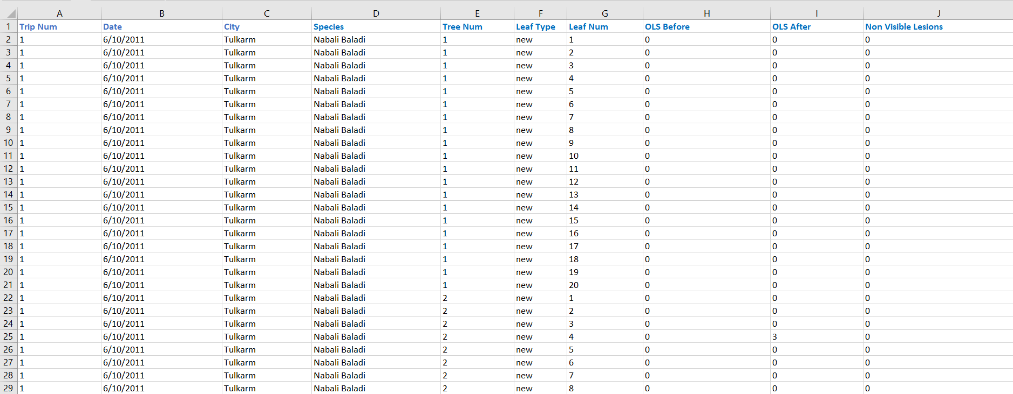
Data Example

Slide 9

Data Utilization
Split the data into three Sets:
Training Set, Validation Set, Testing Set
Train Machine Learning Models.
Recognize Trees Features.
Analyzations and predictions .

Slide 10

Programing Language and Libraries

Slide 11

Programming Language: Python
Libraries Used:
pandas.
sklearn.
numpy.
calendar.

Slide 12

Machine Learning
Algorithms

Slide 13
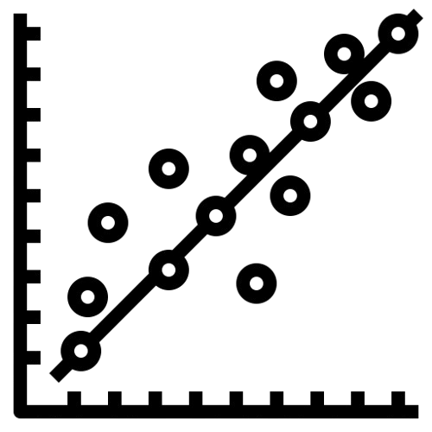
Linear Regression
Linear Modeling Technique.
Used for Regression Problems.
Assumes Linear Relationship.
Predicts Numeric Values.

Slide 14
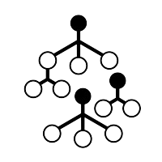
Random Forest Regressor
Ensemble Learning Method .
Combines Multiple Decision Trees.
Reduces Overfitting.
Effective for Complex Data.

Slide 15
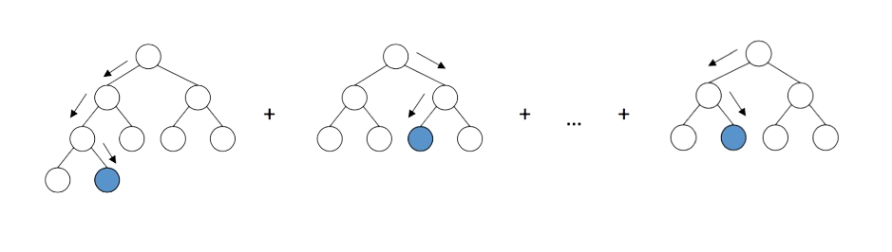
Gradient Boosting Regressor
Ensemble Learning Method.
Builds Trees Sequentially .
Corrects Errors of Previous Trees.
High Predictive Accuracy.

Slide 16

Project Outcome

Slide 17

Disease Characteristics
We got a lot of interesting results regarding the data we have.
The disease spreads mostly during the winter and cold months.
The disease does not affect a lot of trees.
The disease can be stopped by almost 50% using the methods in our data.

Slide 18

Technical Results
The Random Forest Regressor yielded the best results in all three tests.
Comparing it to the other Models using performance metrics like: MSE, and R2 score.
The Random Forest Regressor yielded the most accurate predictions and analyzations due to its nature of reducing overfitting

Slide 19

Any Further Information Needed ?

Slide 20

Done By
Yaman Salman 11926532
Mahmoud Suwwan 12011679
Ameed Malhis 12011326

